Slide 1

IRON MAIDEN: 2 Minutes to Midnight

Slide 2
Intended Game System: Xbox One Target age of players: 13+
Intended ESRB Rating: T (13+) Blood, mild language, violence

Slide 3



Slide 4
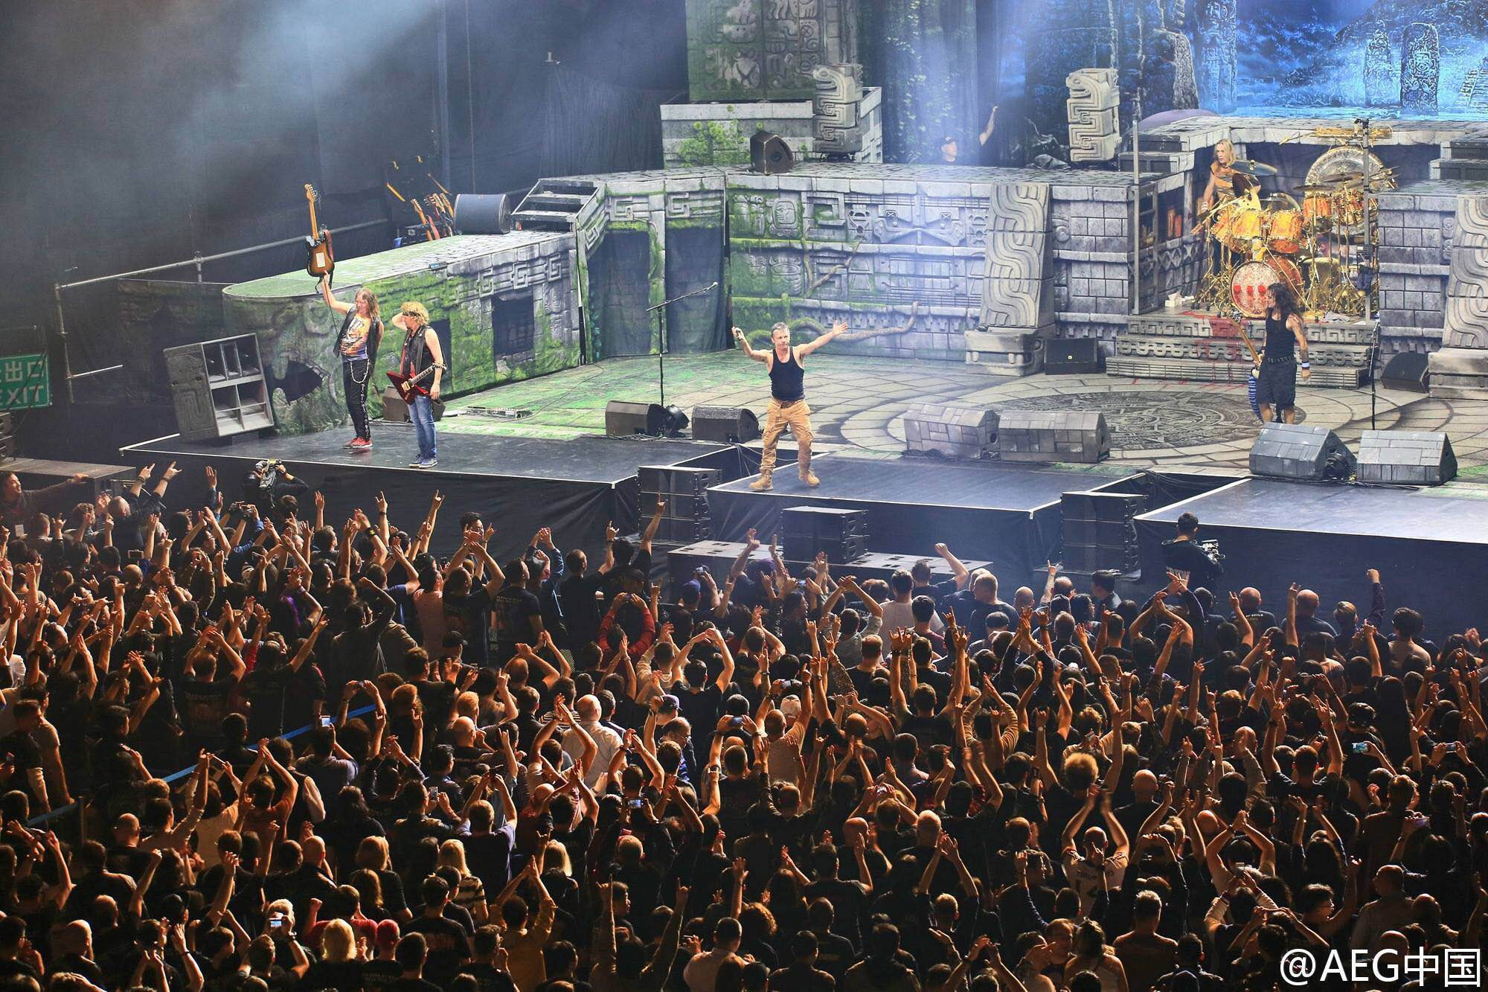

Slide 5
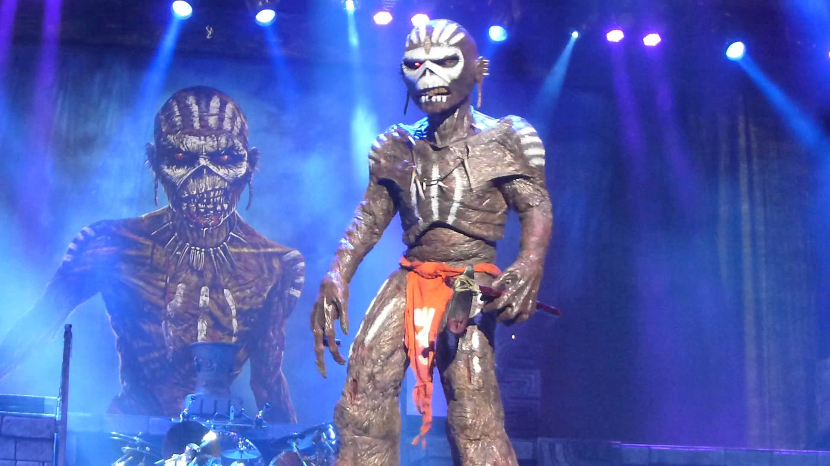

Slide 6
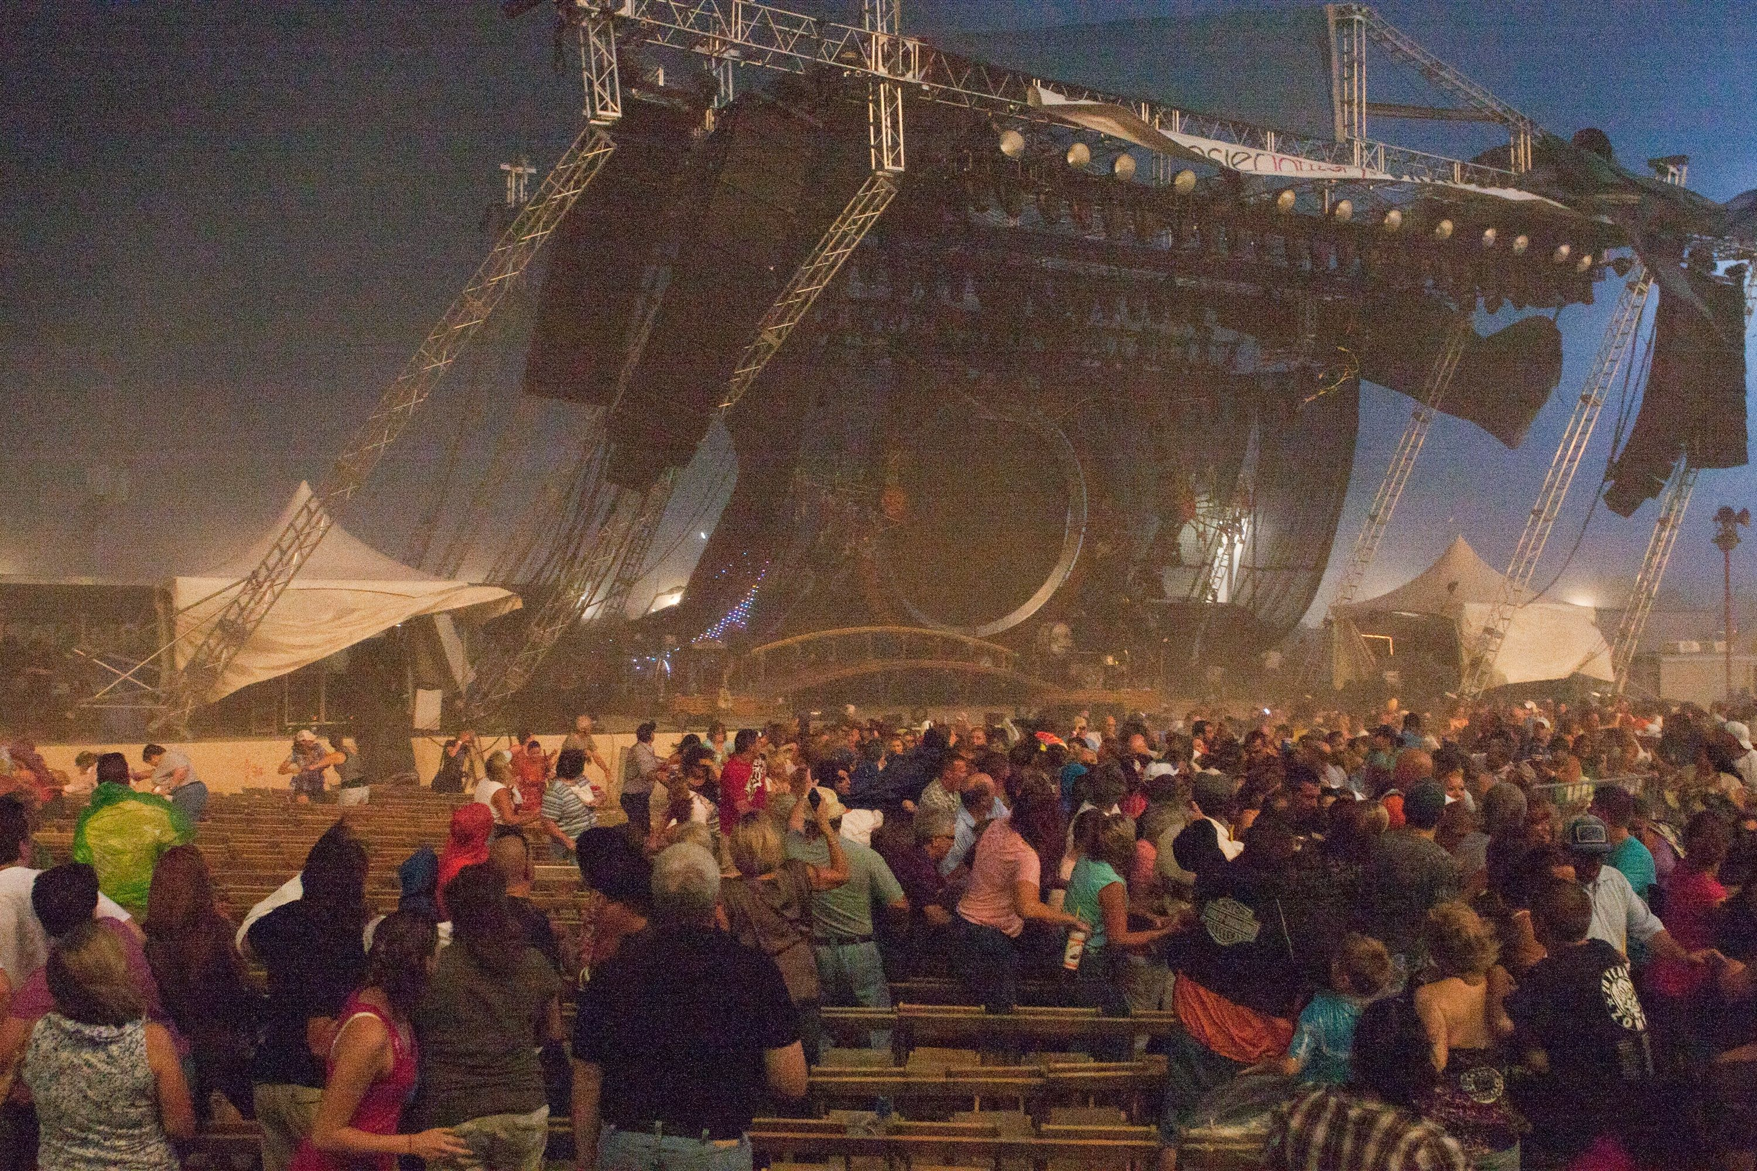

Slide 7

YOU'RE DEAD!
GAME OVER???

Slide 8
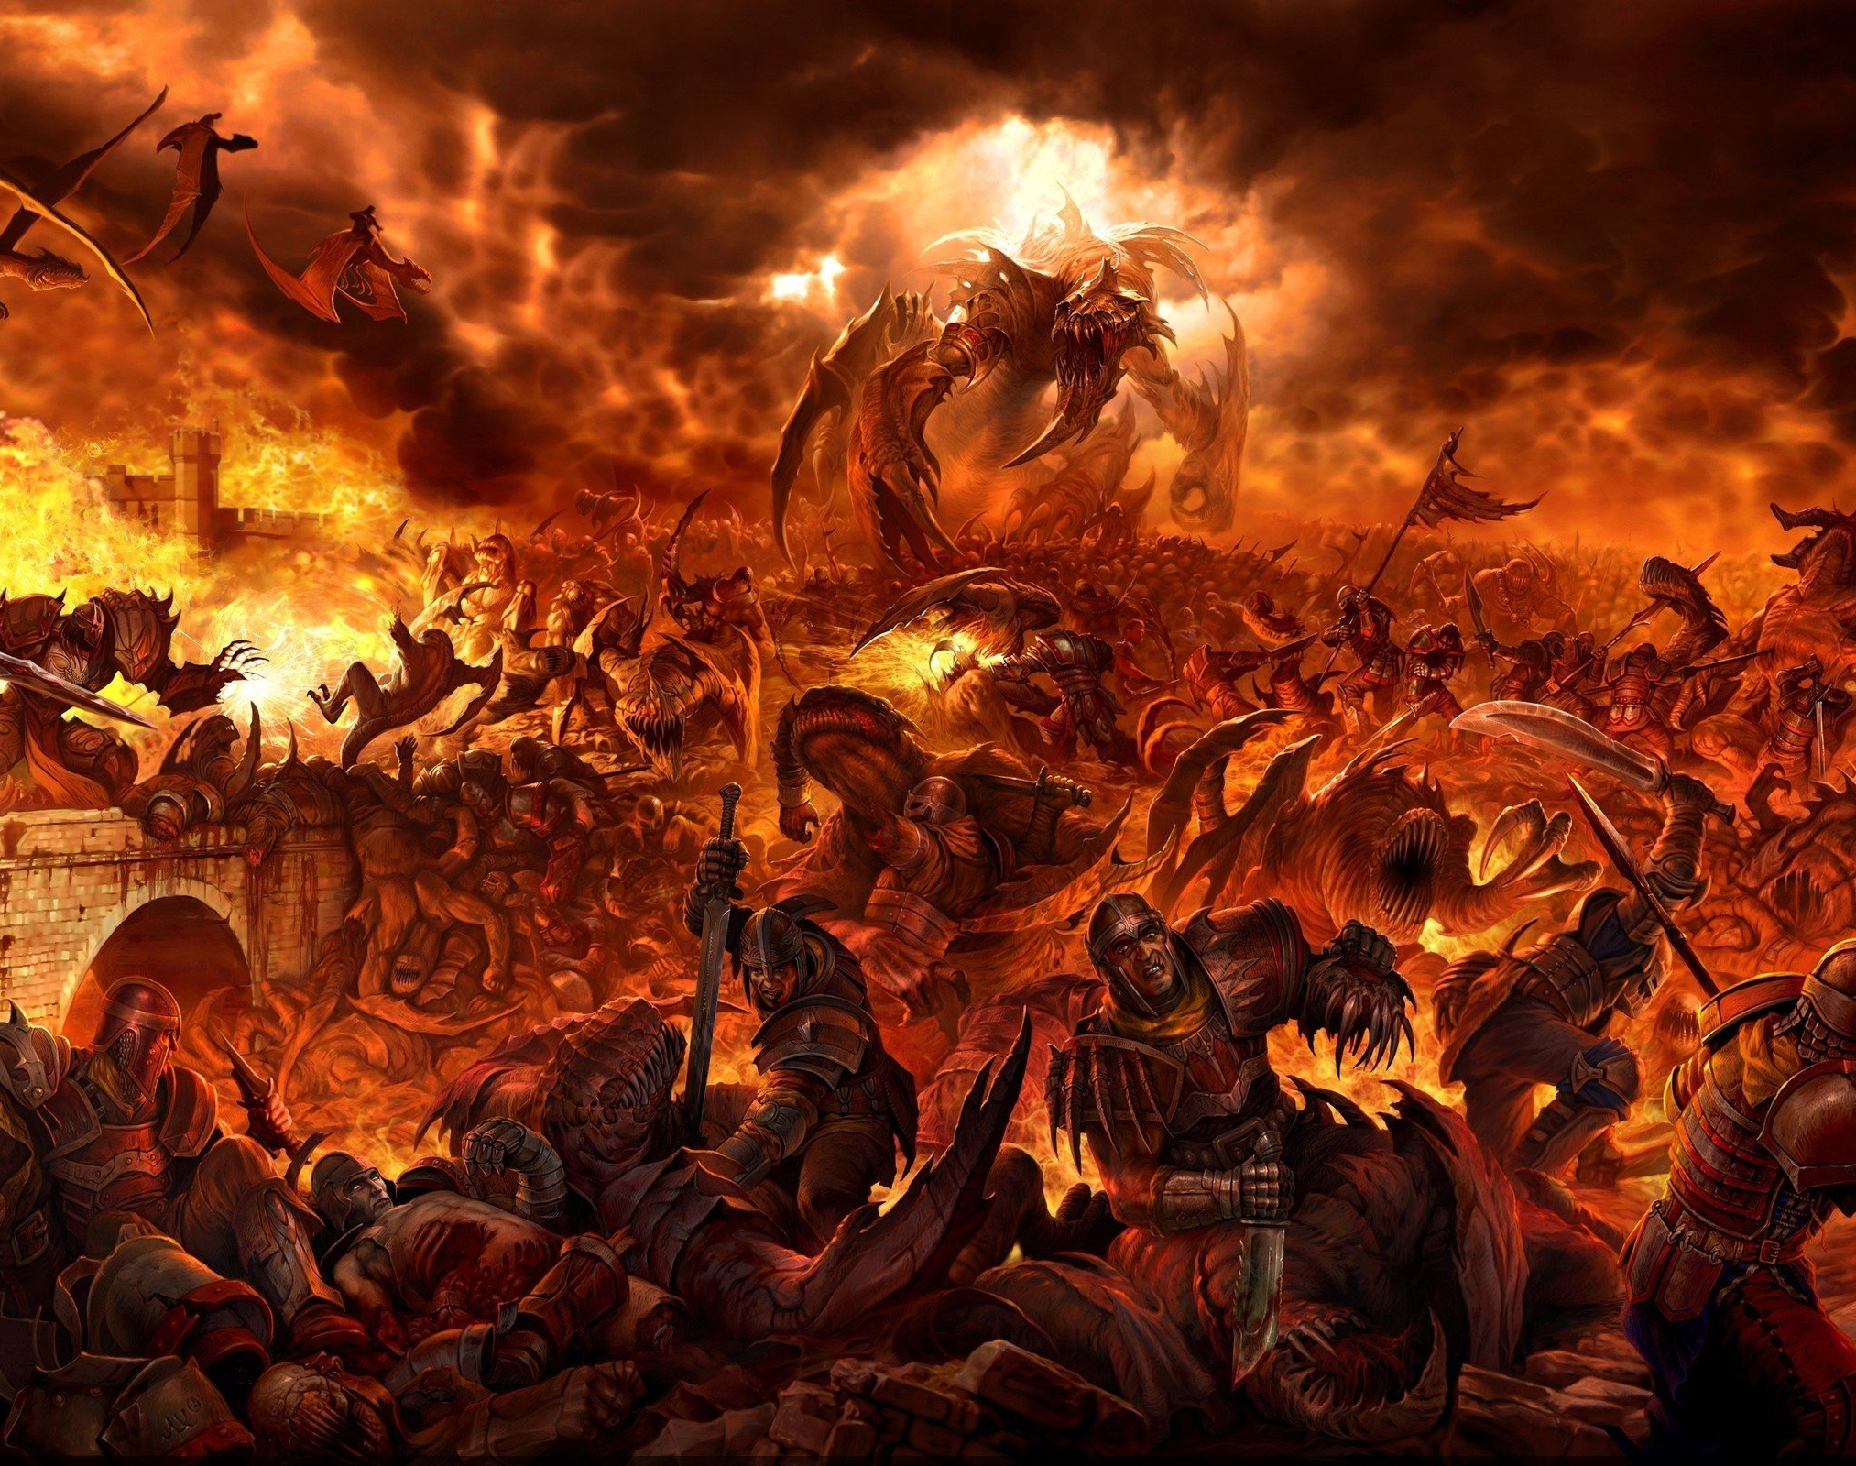
NOT YET...
Welcome to HELL!!!

Slide 9


Slide 10

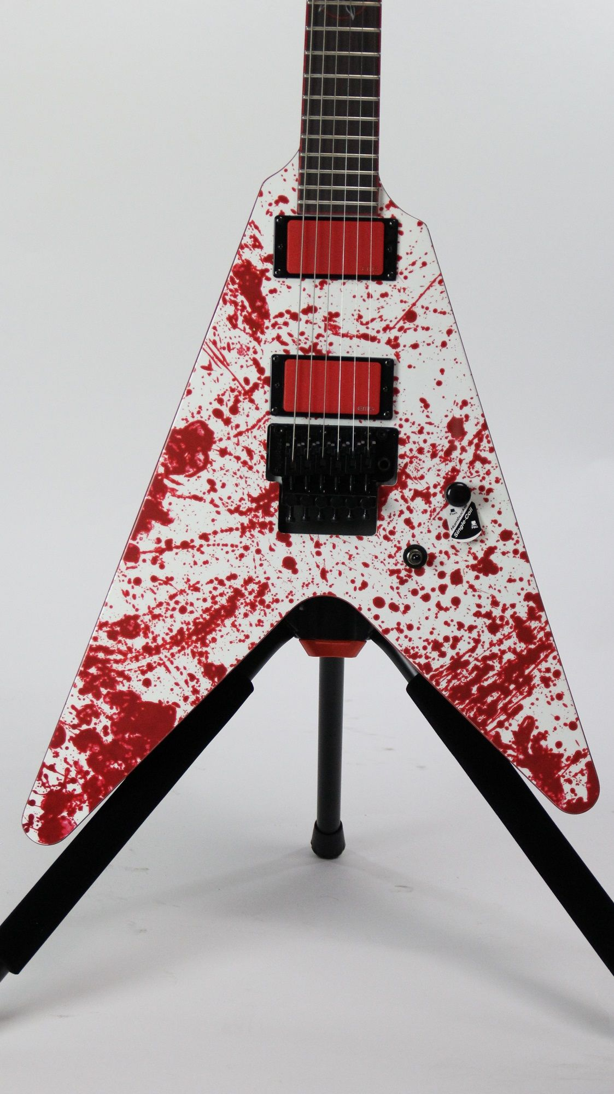

Slide 11
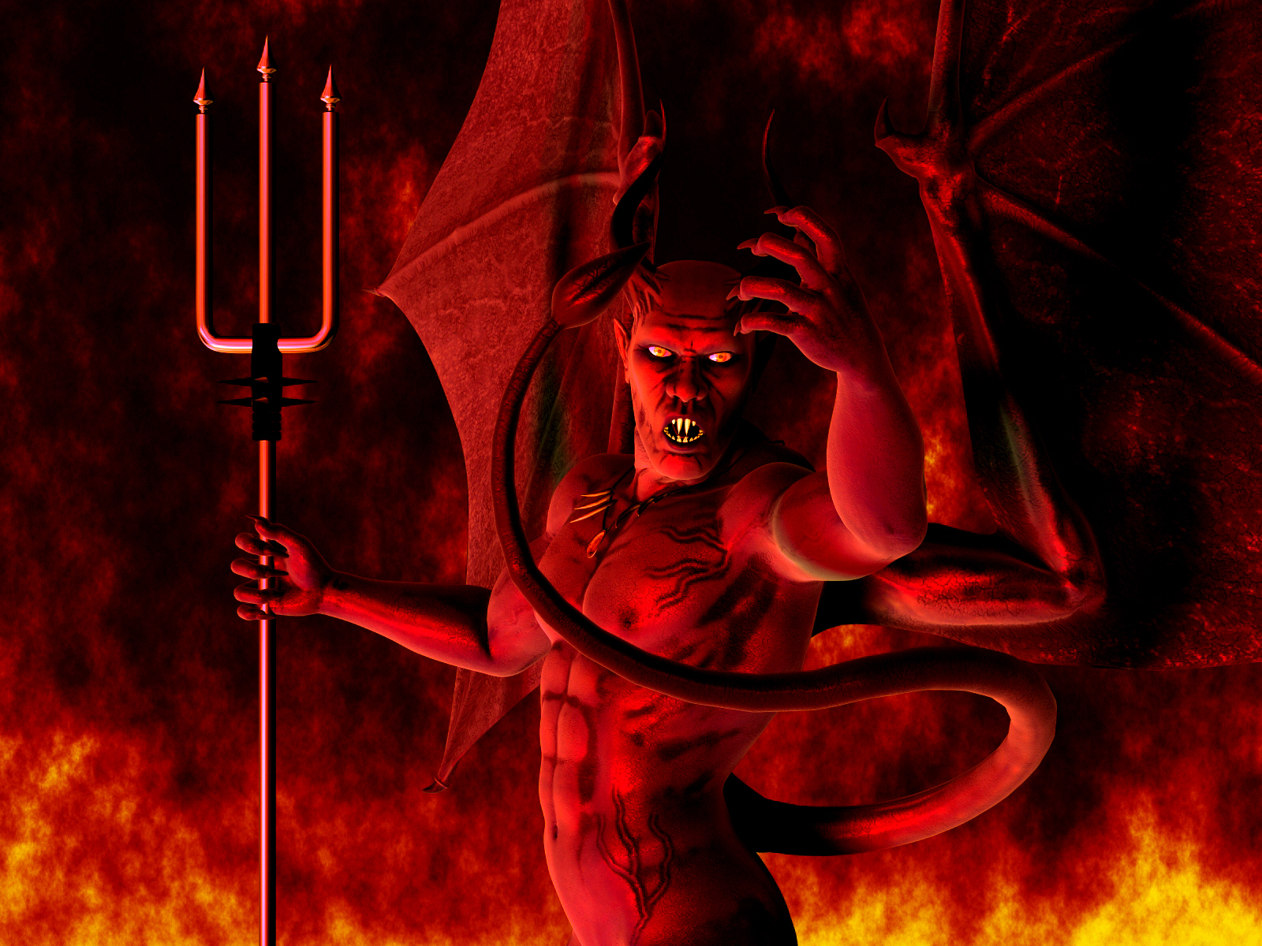

Slide 12

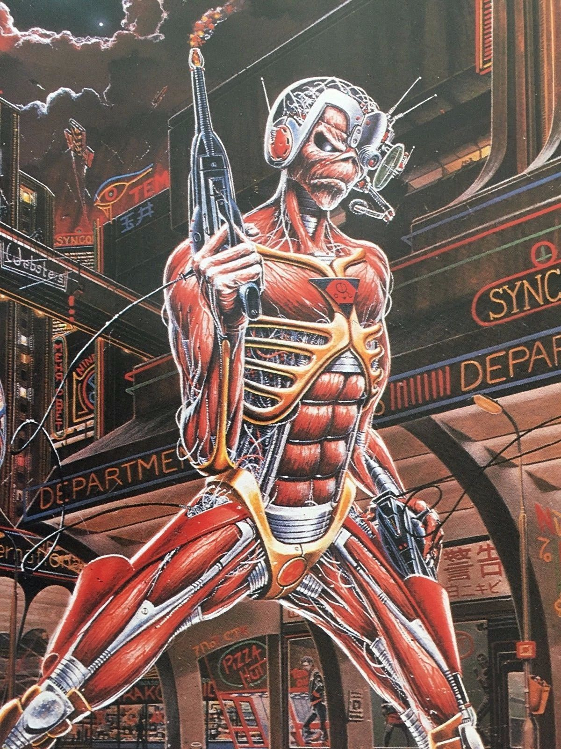

POWER BOOSTS!!!

Slide 13
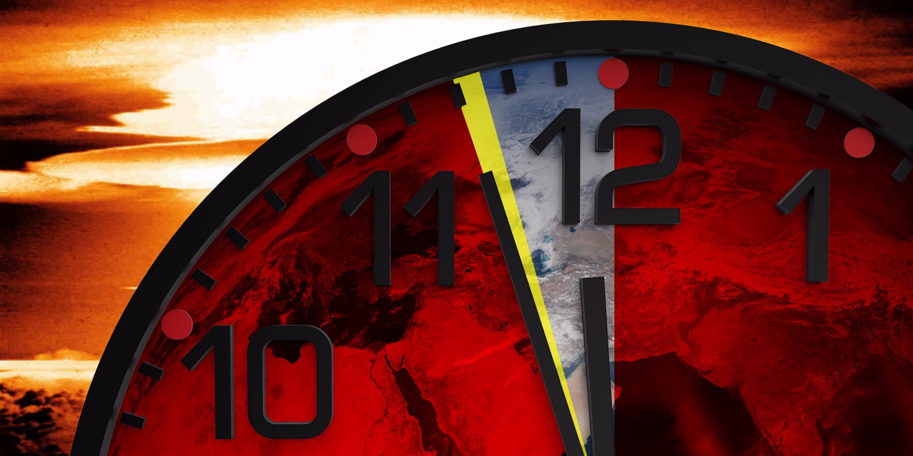

Slide 14
Distinct Modes of Gameplay:
Story Mode
2 Player Mode
Story mode, players need to navigate their way through levels to perturb the physical challenges that stand in the way of Eddie’s ultimate freedom.
2 player mode, fight along side a friend, (online, or locally) completing story mode. 2 Eds is better than one!

Slide 15
Unique Selling Points:
Countless levels to uncover and master
Defeat hordes of Hell Demons who stand in your way of freedom
8-bit versions of songs by the band Iron Maiden
Use the environmental boosts to become different versions of Eddie- giving you weapon bonuses
Great appeal for nostalgic fans of both retro games, and Metal!

Slide 16
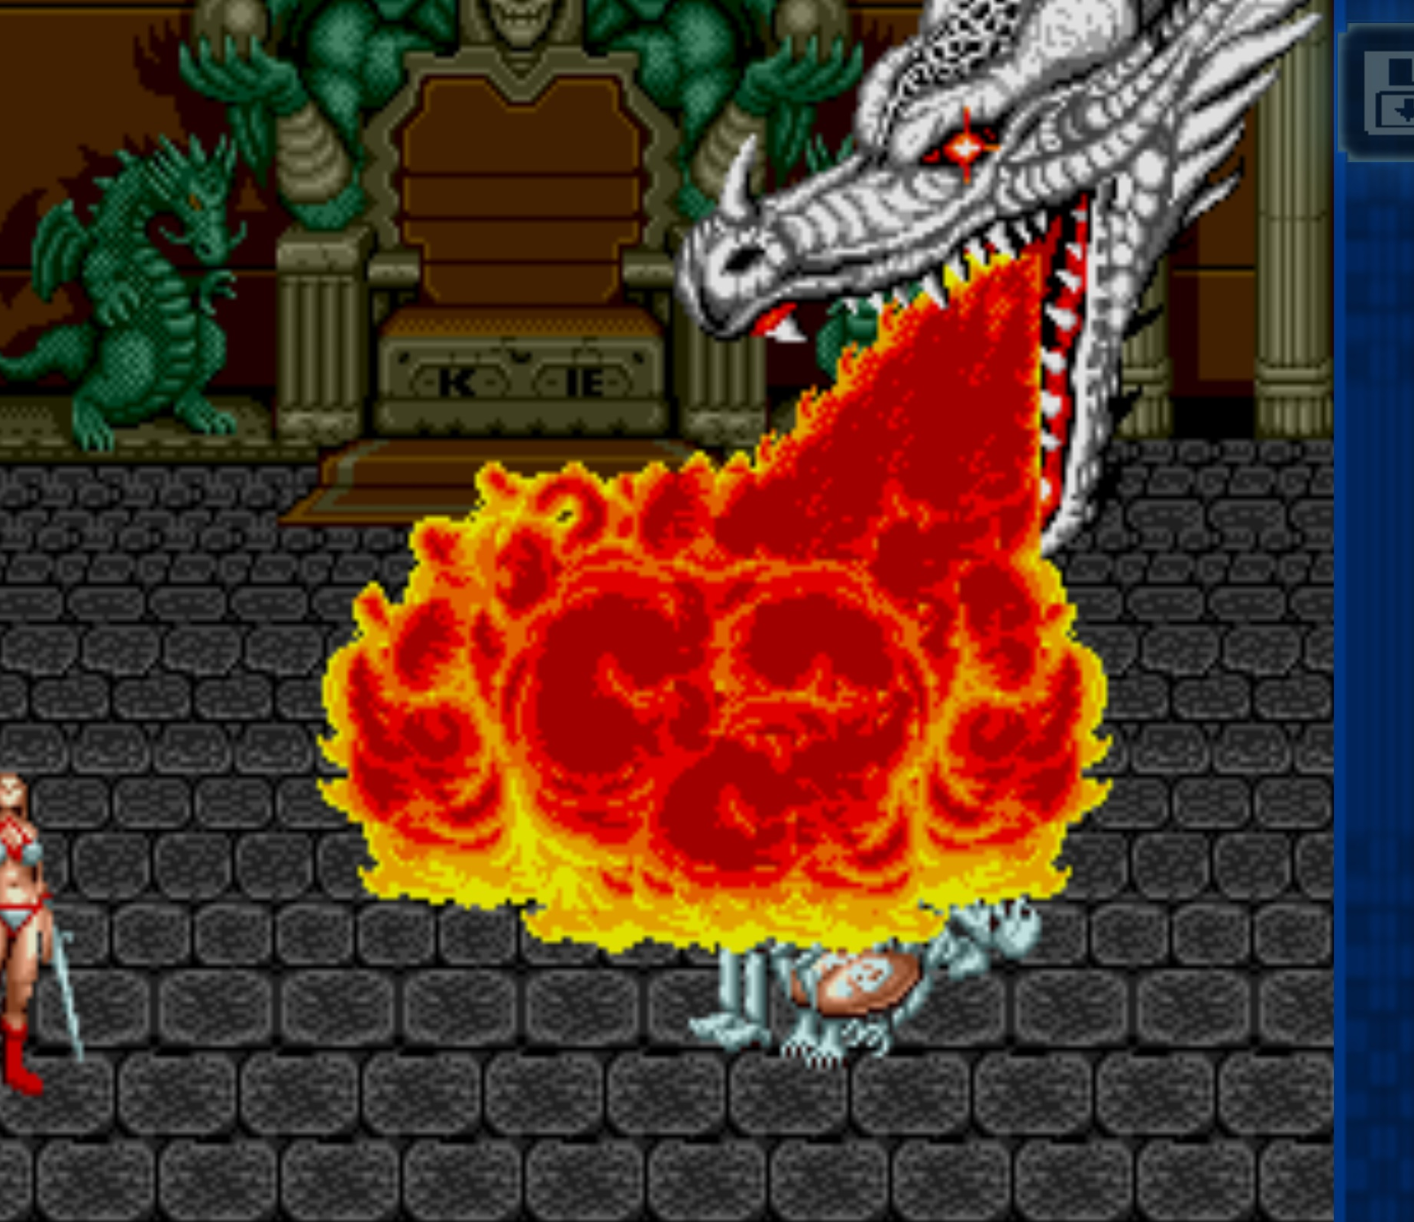
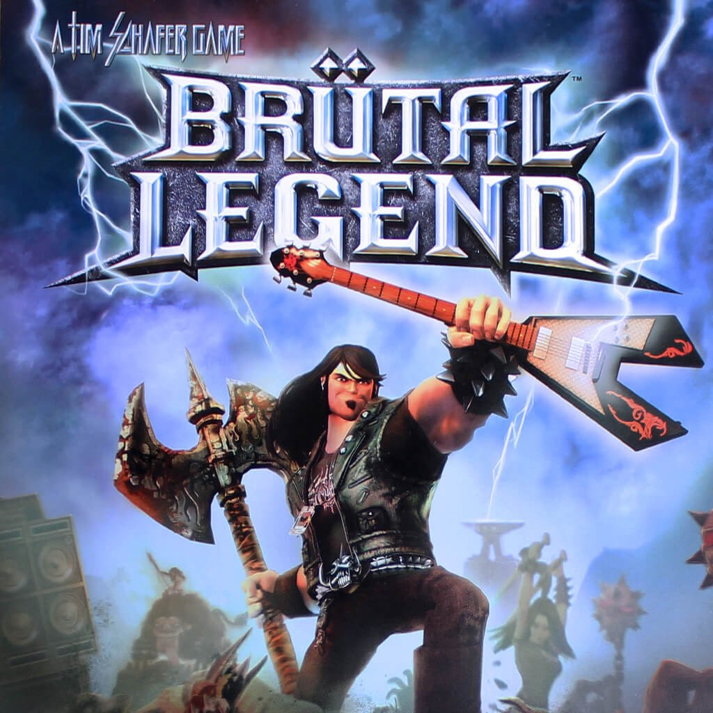
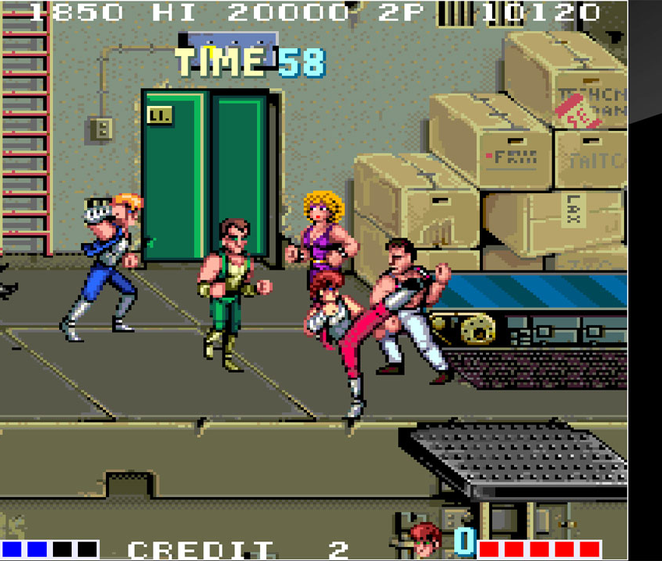
Competitive Products:
Double Dragon
Golden Axe
Brutal Legend

Slide 17


